Slide 1
Novartis Chemical Universe Searching (Astronomically) Large Spaces
NIBR
NX-SIGMA
Cheminformatics
Brian Kelley
RDKit UGM
October, 2016

Slide 2
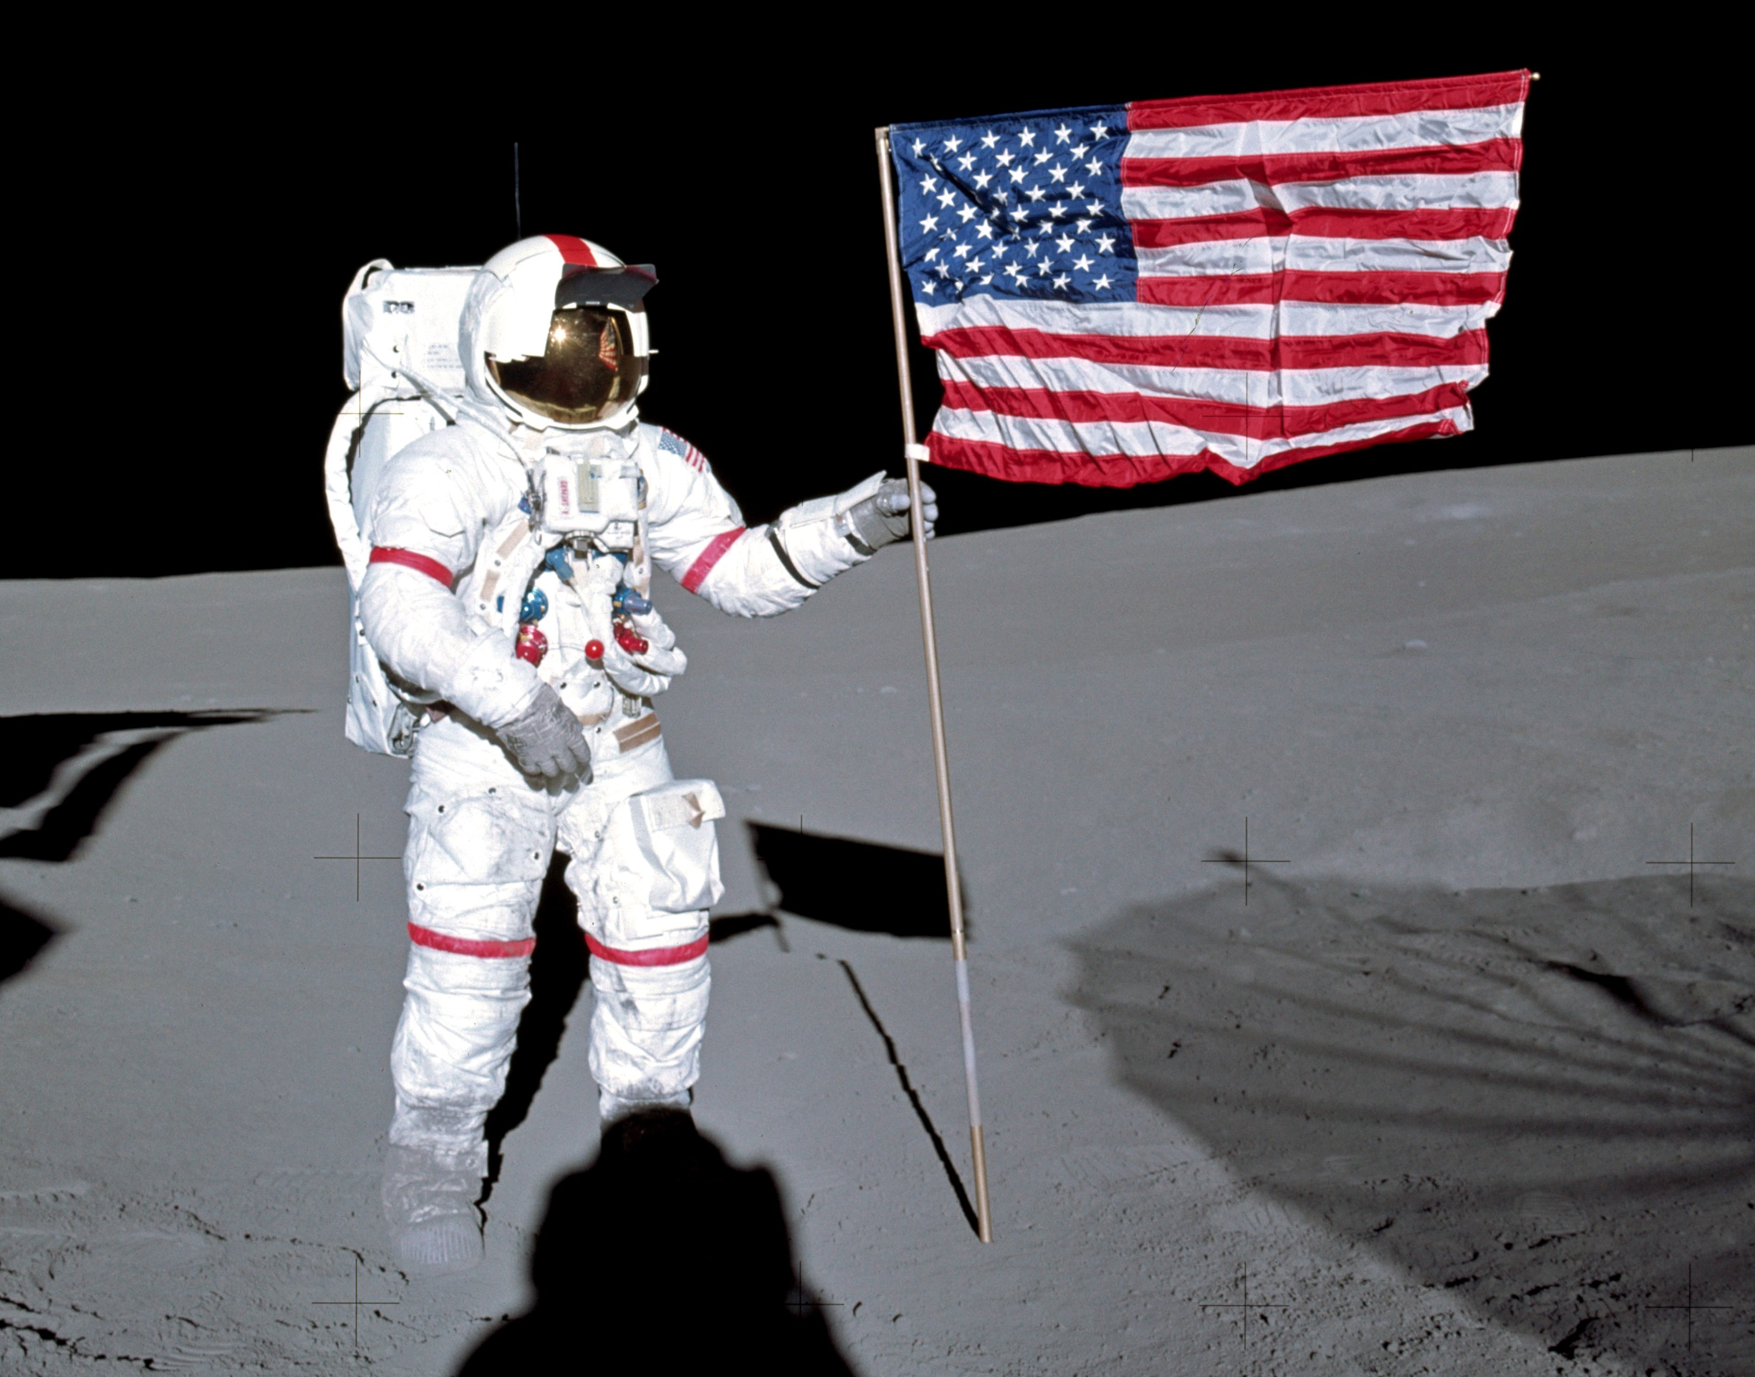
What is the NCU?
What are we searching for?
New Heaven and Earth
I, new-awakened, with my hand stretching out and touching the unknown, the real unknown, the unknown unknown.
DH Lawrence (not Rumsfeld)
I claim this land for Novartis
www.nasa.gov (Alan Shepard)

Slide 3
We are not alone in the universe
The Proximal Lilly Collection: Mapping, Exploring and Exploiting Feasible Chemical Space.
Nicolau C et al.
J Chem Inf Model. 2016 Jun 27

Slide 4
Known Knowns
Internal/External Screening compounds 10s of millions
DNA Encoded Libraries 100s of millions
Available reagents 100s of thousands
Reagents used sometime-somewhere 1s of millions

Slide 5
Known Knowns
Reactions
Functional Groups (Aldehyde/Carboxylic acid …)
59 Robust Reactions
(internal) Condensed Multistep reactions (~1K)
(External) Photochemistry, C-H Activation
Lilly annotated reaction set
A Collection of Robust Organic Synthesis Reactions for In Silico Molecule Design
J. Chem. Inf. Model., 2011, 51 (12), pp 3093–3098
DOI: 10.1021/ci200379p

Slide 6
Known Unknowns
Is a reagent compatible in a reaction?
Can we use new reagents with reactions we have already done?
If so will the products be useful in products?
Soluble?
Drug Like?
Active?
Novel?
Is the NCU feasible?
What is the utility?
Who enters new reactions?

Slide 7
Unknown Unknowns
Photochemistry
Source
wikipedia

Slide 8
What is a reaction?
Electronic representation of chemical reality
Various levels of chemical fidelity
Most electronically described reactions are only valid within a smallish window of reagents.

Slide 9
What is a reaction?
Negishi Coupling
organohalide
organozinc
Pd
alkenyl, aryl, allyl, alkynyl or propargyl
chloride, bromide,
or iodide, (triflate and acetyloxy)
Zn + (chloride, bromine or iodine)
alkenyl, aryl, allyl, alkyl benzyl, homoallyl, and homopropargyl.
C-C
coupling

Slide 10
What is a reaction?
Negishi Coupling (SMARTS Encoding)
[#6;$([#6]~[#6]);!$([#6]~[S,N,O,P]):1][Cl,Br,I].
[Cl,Br,I][#6;$([#6]~[#6]);!$([#6]~[S,N,O,P]):2]
>>[#6:2][#6:1]
Got it?

Slide 11
What is a reaction?
Negishi Coupling (SMARTS Encoding)
[#6;$([#6]~[#6]);!$([#6]~[S,N,O,P]):1][Cl,Br,I].
[Cl,Br,I][#6;$([#6]~[#6]);!$([#6]~[S,N,O,P]):2]
>>[#6:2][#6:1]
Reagent1
Reagent2
Product
(C-C coupling)

Slide 12
What is a reaction?
Negishi Coupling (SMARTS Encoding)
[#6;$([#6]~[#6]);!$([#6]~[S,N,O,P]):1][Cl,Br,I].
[Cl,Br,I][#6;$([#6]~[#6]);!$([#6]~[S,N,O,P]):2]
>>[#6:2][#6:1]
Cl ➔slow
Missing
triflate,
acetyloxy

Slide 13
What is a reaction?
Most reactions in the NCU are so called template based reactions
A+B => C
Makes it easy™
organozinc
organohalide

Slide 14
What is a reaction?
Risks
Enough information to get the known reagents, not enough information to know the incompatible.
Hydrogens ( and electronic environments ) are tricky
For now, lets say the NCU is an “idea” generator backed by good but not great knowledge of chemistry.
Is that
really
an aldehyde?
Can R be a hydrogen?

Slide 15
Reactions in RDKit Space
MD Reaction files
Smarts based reactions (not smirks, but superset)

Slide 16
New RDKit Reaction tools
SanitizeRXN - simple fixes for common reaction failures
Auto detect atom maps from Rgroups (ChemDraw/ICM)
Auto convert dummy atoms to RGroups
Attempt to add aromaticity to MD Files for reaction searching

Slide 17
New RDKit Reaction tools
Enumerate – enumeration class for enumeration and sampling
Different sampling strategies can be used
ALL – uses current strategy
RandomSample – standard random sampling
RandomSampleAllBBs – enforces sampling of all reagents
EvenSamplePairs – useful for sampling a small number of products trying
to use as many pairs of reagents as possible
Picklable
pickle and restore building blocks and reaction
Restartable
get nth sample, save state and continue later.

Slide 18
QSAR in enumeration space
Atoms
“hashed”
Into integer
1233244
443211
334451
Almost Additive
Somewhat Additive

Slide 19
Additive fingerprints
Grieco three component condensation

Slide 20
Additive fingerprints
Reagents
Products
Self similarity by adding bits
.7 (radius = 1)
.6 (radius = 2)

Slide 21
Use information you have
Products
Must be C-a bond
Either: C-C c-C or C-c
Separate reactions that make different
environments to add bits that *must* exist
Self similarity by adding bits
.9 (radius = 1)
.8 (radius = 2)

Slide 22
Search Strategy
Generate fps for each reagent in the context of the reaction
Sort reagents by similarity to target, choose top N to fully enumerate.
Bits = fingerprint of regeant+scaffold
- fingerprint of scaffold

Slide 23
Search Strategy
query
Grieco three component condensation
Search Time 5s
(500 Billion products)

Slide 24
Glare: or where are the class-m(olecule) planets
Some Properties are easier than others
LDC Criteria
MW < 650
CLOGP < 6.5
PSA < 170
ROTORS < 10
UNDEFINED STEREO CENTERS <=4
And Fingerprints are (kinda) additive as well.

Slide 25
Glare
A 1 a
B 2 b
C 3 c
D 4 d
E 5 e
F 6 f
G 7 g
H 8 h
I 9 i
G 9 h
C 5 i
E 4 d
H 3 c
A 2 e
I 8 g
F 7 a
B 6 f
D 1 b
G 9 h
C 5 i
E 4 d
shuffle
Partition
H 3 c
A 2 e
I 8 g
F 7 a
B 6 f
D 1 b

Slide 26
Glare
G 9 h
C 5 i
E 4 d
G9h
G9i
G9d
G5h
G5i
G5d
G4h
G4i
G4d
C9h
C9i
C9d
C5h
C5i
C5d
C4h
C4i
C4d
E9h
E9i
E9d
E5h
E5i
E5d
E4h
E4i
E4d
Fully
Enumerate
Partition
H 3 c
A 2 e
I 8 g
F 7 a
B 6 f
D 1 b

Slide 27
Glare
Score
G 9 h
C 5 i
E 4 d
G9h
G9i
G9d
G5h
G5i
G5d
G4h
G4i
G4d
C9h
C9i
C9d
C5h
C5i
C5d
C4h
C4i
C4d
E9h
E9i
E9d
E5h
E5i
E5d
E4h
E4i
E4d
Fully
Enumerate
Partition
H 3 c
A 2 e
I 8 g
F 7 a
B 6 f
D 1 b

Slide 28
Glare
Score
G 9 h
C 5 i
E 4 d
G9h
Fully
Enumerate
Partition
Additive Properties
(MW, alogp, TPSA, fp bits)
H 3 c
A 2 e
I 8 g
MW(G) + MW(9) + MW(h) +
core
G,9,h => added sidechains
not reactants
F 7 a
B 6 f
D 1 b

Slide 29
Glare
Score
Reagents in
“good”
Products
G-0
C-6
E-2
9-5
5-3
4-0
h-3
i-4
d-3
G 9 h
C 5 i
E 4 d
G9h
G9i
G9d
G5h
G5i
G5d
G4h
G4i
G4d
C9h
C9i
C9d
C5h
C5i
C5d
C4h
C4i
C4d
E9h
E9i
E9d
E5h
E5i
E5d
E4h
E4i
E4d
Fully
Enumerate
Partition
H 3 c
A 2 e
I 8 g
F 7 a
B 6 f
D 1 b
Notes:
Indicate that you do this again iteratively

Slide 30
Glare
A 1
B 2 b
C 3 c
d
E 5 e
F f
7
8 h
I 9 i
A 9 h
F 5 i
I d
B 3 c
E 2 e
C 8
7
f
1 b
Iterate
until
“done”
shuffle
Partition

Slide 31
Glare
Takes about 1 minute to search 200 billion products
400 lines of python
Including comments
Truchon. Bayly. Jchem Inf Model 2006 Jul-Aug;46(4):1536-48.
GLARE: a new approach for filtering large reagent lists in combinatorial library design using product properties.
https://commons.wikimedia.org/wiki/File:PIA19341-MilkyWayGalaxy-SpiralArmsData-WISE-20150603.jpg

Slide 32
QSAR in reaction space
Start with
a Reaction
Get compatible
reagents
Annotate Sidechains
MW
ALOGP
Fingerprints
Enumerate
and rescore
Optimize
Library
Properties
Target
Model

Slide 33
Finding needles in haystacks
DNA Encoded
Negishi
Optimized
DNA Encoded Library ~ 150M compounds
Single Reaction synthesis is “top” 150 million out of ~200 billion
– More variety in Negishi Reaction reagents.

Slide 34
Finding needles in haystacks
Not a be all end all
Need the reactions
Need the reagents
Puts a *lot* of pressure on your models.
But…
Fast (at least get the wrong answers quicker)
Can now use QSAR models to help choose reagent diversity
When dealing with trillions of products…

Slide 35
Acknowledgements
Aileen Novero (now at Vertex)
Gregory Landrum (RDKit/Knime)
Nik Stiefl (Novartis)
Clayton Springer (Novartis)
Andrew Dalke (ChemFP)
Michael Tarselli (Novartis)
Margaret Pancost-Heidebrecht (Novartis)

